Slide 1
Planning Your Own High Adventure
Terry McKibben
BSA Troop 344/9344
Pemberville, OH
troop344leaders@gmail.com

Slide 2
What is a High Adventure
Exhilarating outdoor experience
Living and cooperating with others
Using outdoor skills
Overcoming difficulties
Living in harmony with nature
Leadership
Camaraderie
Experience God’s creation
Commitment to wilderness stewardship
Meaningful and lasting experience

Slide 3
Why go on a High Adventure
FITNESS
To develop fitness - develop physical, mental, emotional, and moral fitness that will stay with a Scout for the rest of his life.
CITIZENSHIP
CHARACTER
To foster citizenship - foster love of community, country and world, along with a commitment of service to others and an understanding of democratic principles.
To build character - build self-reliance, self-discipline, self-confidence and self-respect.

Slide 4
Why go on a High Adventure
High adventure increases youth retention.
Retention increases exposure to Scouting values.
Younger Scouts have outings to aspire to.
Older / Venture Scouts are motivated to remain involved.
Scouts who have gone on a High Adventure are more likely to return as Scouters.
Their children are more likely to join Scouts.
Or simply, fun with a purpose!

Slide 5
The Cost of BSA High Adventures
A rough rule of thumb is that the actual fee is about one third of your overall budget.
The balance is spent on airfare, ground transportation, meals, tour and sightseeing expenses, crew gear and training.
Total trip expenses for a typical group range from $1,500-$2,300 per person.

Slide 6
Why Most of Us Don’t Get Started
It’s too expensive…
Not true!!
A great high adventure trip doesn’t have to cost a lot – we’ve done backpacking trips of three days for less than $50 all inclusive.
Our ten to twelve day trips are about one third of the total cost for our Council-led contingents to the BSA bases and cost between $550-$850.

Slide 7
Why Most of Us Don’t Get Started
I don’t have the time…
Yes, you do!!
Vacation days are precious when you have a family and you can’t invest all of them in a Scout trip.
You can take 3-4 days; leave on Wednesday and return on a Monday.
Even allowing a day of travel each way you’ll have a 4 day adventure.
If you are the parent of a Scout you have a limited opportunity to enjoy this with your son – 2 to 4 years.
Trust me, there are a LOT of years afterward.
Take the days and head into the wilderness with your son; you won’t forget it.

Slide 8
Why Most of Us Don’t Get Started
I don’t have the skills or confidence.
Most people don’t; they have to learn them.
One of the best parts of a High Adventure trip is the months spent planning, learning and practicing skills.
Many back-country groups are very inexperienced and ill-prepared yet survive and flourish in the outdoors.
You will be more prepared than most of them.

Slide 9
How to Get Started
Here’s my advice:
Select a modest goal and be the spark plug to make this happen.
You can use one of our trips as a blueprint for your own.
Start planning now.
You’ll do more for your patrols and troop than you can imagine.
Don’t complicate things – make it accessible financially and time-wise.

Slide 10
Why Do Your Own Trips
Why go beyond the Big 3?
The Big 3 are sometimes hard to get into, especially Philmont.
Planning your own trip gives you:
Choices of many other great destinations.
Engage your personal passions – national parks, canoeing/kayaking, bicycle trips, etc.

Slide 11
Why Do Your Own Trips
Planning and Preparing
Building your own high adventure program is very rewarding.
This calls for crew members to be much more involved with the process (especially the scouts) and therefore makes the trip all that much more worthwhile.
Scouts and leaders derive great satisfaction and valuable experience when they do it for themselves.

Slide 12
Why Do Your Own Trips
Flexibility
You can schedule trips in a much more flexible time frame and match the challenge level to the participants.
You can also plan the pre-trip shakedowns and meetings to suit your schedules.

Slide 13
Why Do Your Own Trips
Crew Dynamics
Council contingents fill predetermined crew sizes.
You could get to spend a week or so with scouts or leaders you don't know.
This may be a chance to make new friends, or turn into a real ordeal.
Filling a crew from a single troop where everyone is familiar with one another makes the outcome much more predictable.

Slide 14
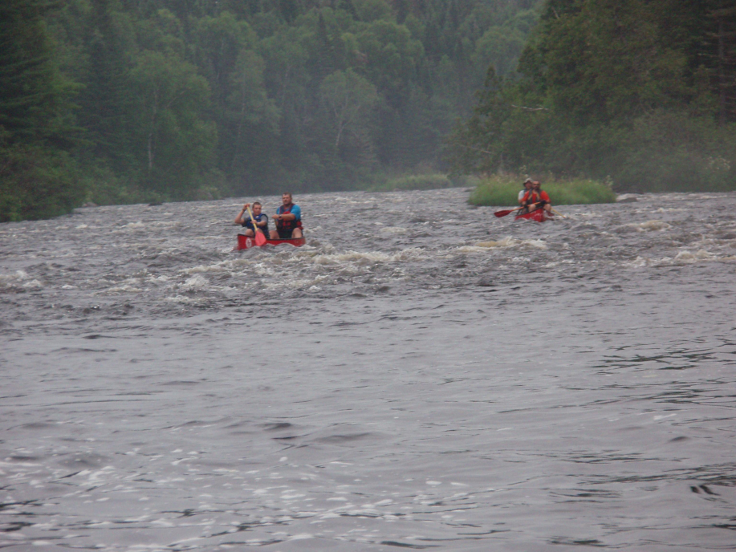
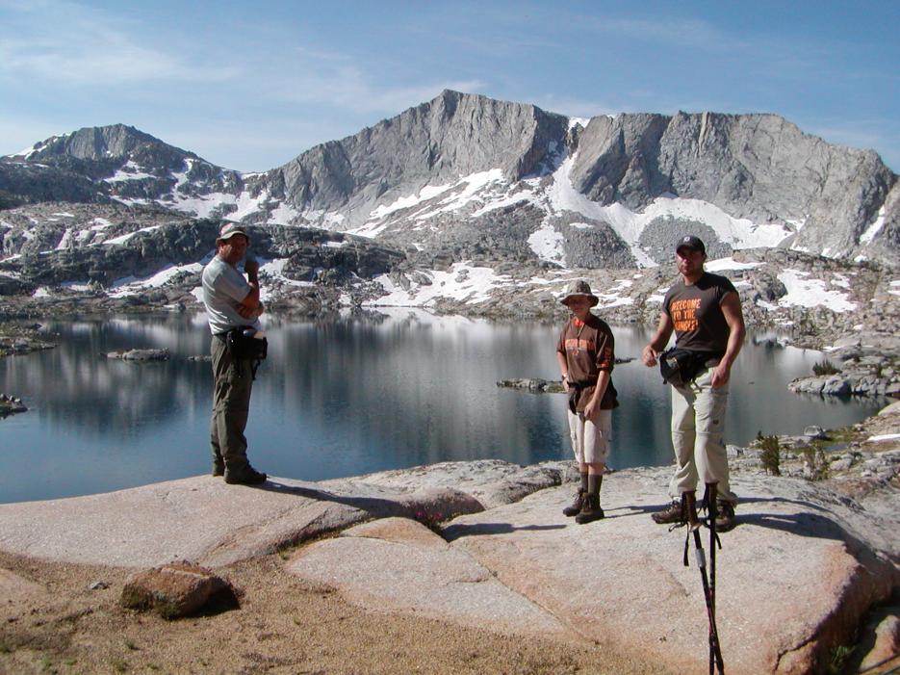
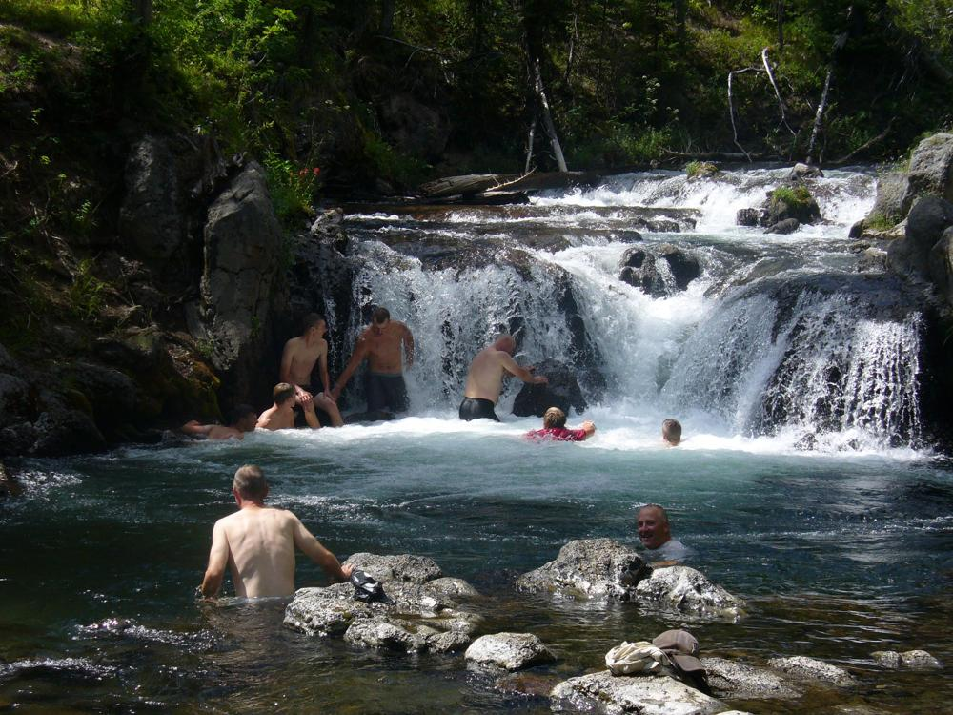
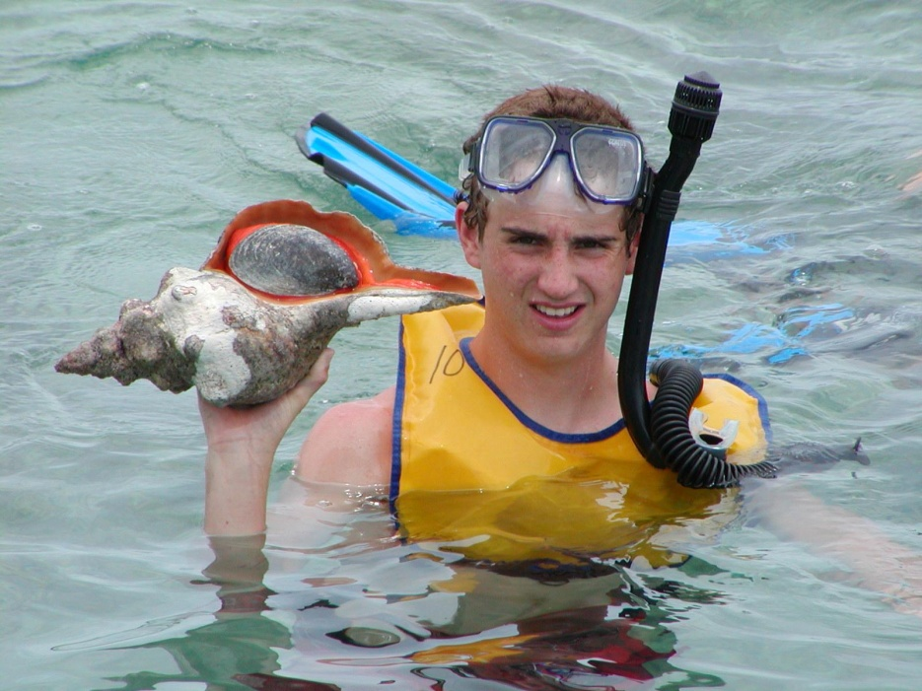
Trip Examples

Slide 15
Troop 344/9344 Requirements for High Adventure Experiences
A Scout must be a minimum of 14 years old by December 31st during the year of the high adventure trip.
A Scout must obtain the rank of Star prior to trip departure.
An up to date Annual Health and Medical Record, Part A, B, and C, must be on file with the Troop.
The Troop leadership reserves the right to reject any participation request if in their judgment it would compromise the safety of the individual or other participants.
**Note: The Troop leadership, at their discretion, may alter requirements 1 and 2 based upon the demands of the high adventure trip. Safety is paramount and any decision to alter requirements will be made so that the safety of the individual or group is maintained.

Slide 16
Itinerary for Yosemite 2012

Slide 17
Yosemite July 22-Aug 3, 2012
Sunday, July 22, 2012
3:30AM ET Depart from Scout Cabin.
5:45AM ET Arrive at Columbus Airport.
7:10AM ET Flight Departs Columbus International Airport
(Flight: Southwest Airlines #2055).
9:35AM PT Flight arrives at Las Vegas Airport. Pick up vans from Valley
Xpress Car Rental. (702) 457-3728
7:00PM PT Arrive at Trailhead Group Campground, Saddlebag Lake.
Monday, July 23, 2012
7:00AM PT Pack up campsite, Tour Yosemite: Mariposa Sequoia Grove,
Set up camp at Bridalveil Creek Group Campground. Stage
one van at Glacier Point. Dayhike to Taft Point – Sentinel Dome –
Glacier Point. Eat supper and watch sunset at Glacier Point.

Slide 18
Yosemite July 22-Aug 3, 2012
Tuesday, July 24, 2012
7:00AM PT Pack up campsite. Pick up wilderness permits at Tuolumne Meadows Wilderness Center. Dayhike to the top of Mt. Hoffman from May Lake Trailhead. Set up camp at White Wolf Campground.
Wednesday, July 25, 2012
7:00AM PT Group 1: Depart from Ten Lakes Trailhead, Hike to Ten Lakes
region. Day mileage - 6.0 miles.
Group 2: Depart from White Wolf Trailhead, Hike to Ten Lakes region. Day mileage - 9.0 miles.
Thursday, July 26, 2012
7:00AM PT Group 1 and 2: Hike to Tuolumne Peak region.
Day mileage - 6.0 miles.

Slide 19
Yosemite July 22-Aug 3, 2012
Friday, July 27, 2012
7:00AM PT Group 1 and 2: Hike to the McGee Lake. Day mileage - 8.0 miles.
Saturday, July 28, 2012
7:00AM PT Group 1 and 2: Hike to Pacific Crest trail junction, drop packs to view Tuolumne Falls, continue hiking and camp below Return Creek in the Grand Canyon of the Tuolumne River. Day mileage - 10.0 mi.
Sunday, July 29, 2012
7:00AM PT Group 1 and 2: Hike to Pate Valley. Day mileage - 8 miles.
Monday, July 30, 2012
7:00AM PT Group 1 and 2: Climb out of the canyon and camp at Harden Lake. Day mileage - 6.5 miles.
Tuesday, July 31, 2012
7:00AM PT Group 1and 2: Hike to White Wolf Trailhead. Camp at White Wolf Campground. Day mileage - 4.4 miles. Pick up vans.

Slide 20
Yosemite July 22-Aug 3, 2012
Wednesday, August 1, 2012
6:00AM PT Depart and stay at America’s Best Value Inn, Las Vegas.
(702) 795-3311
5:00PM PT Dinner at the French Market Buffet in the Orleans Casino, Fountains at the Belagio, Fremont Street Experience.
Thursday, August 2, 2012
7:00AM PT Depart for tour of Hoover Dam.
1:45PM PT Depart Hoover Dam
2:30PM PT Arrive at airport and return vans.
6:00PM PT Flight leaves Las Vegas Airport (Flight: Southwest Airlines #263).
Friday, August 3, 2012
1:00AM ET Flight arrives at Columbus International Airport.
3:30AM ET Arrive at Scout cabin in Pemberville.

Slide 21
How do I plan all of this? (6 easy steps)
Get the “big picture” stuff decided first.
Identify timing for key elements such as national park campground reservations, backpacking permits, etc.
Determine your participation criteria.
Keep your finances straight.
Hold meaningful practice events.
Let the kids have fun!

Slide 22
#1 The Big Picture
Where
When
Who – age and physical capability
Why

Slide 23
#2 Identify Key Timing (Example)
Yosemite Reservations:
Wilderness permit reservations are available 24 weeks (168 days) in advance.
Campground Reservations
Required March 15 through November
The table indicates which day you can first make a reservation for specific dates.
Arrival date | First day to make reservations (7 am PT)
March 15 through April 14 | November 15
April 15 through May 14 | December 15
May 15 through June 14 | January 15
June 15 through July 14 | February 15
July 15 through August 14 | March 15
August 15 through September 14 | April 15
September 15 through October 14 | May 15
October 15 through November 14 | June 15
November 15 through December 14 | July 15

Slide 24
#3 Determine Participation Criteria
Objective criteria:
Age and rank
Participation in troop activities
Participation in trek practice events
Subjective criteria: “Readiness”
Physical ability
Emotional maturity
Teamwork spirit
These are your responsibility

Slide 25
Key to Success
Honestly evaluate the ability, attitude and maturity of all interested scouts and adults.
Do not take scouts or adults that are not ready.
This is a disservice to the scout and the rest of your crew.

Slide 26
#4 Keep Finances Strait
Communicate the total cost of the trip including transportation, crew equipment, side trips, etc.
Collect payments from participants ahead of non-refundable expenses.
Publish a refund policy with key dates.
Follow-up quickly with late payments – can be a sign of pending drop-outs.

Slide 27
Yosemite High Adventure Cost/Person
Estimated Trip Expenses: (Cost estimates are based on 18 people participating)
Van Rental $1800.00 $1800.00
Gas 110 gallons @ $4.00/gal $440.00
Flight Tickets 18 x 442.40 $7963.00
Food $1800.00
Campground Fees/Permits/Parking $415.00
Hoover Dam Tour $222.00
Motel $222.00
Miscellaneous expenses $350.00
Total cost $13212.00
Cost per person (total cost ÷ 18 participants) $734.00
We will collect $750.00 per person.
**Scouts will need spending money for lunch on Mon, July 26, lunch on Thurs, Aug 5, and any souvenirs they desire to purchase.
**Any money left over after the trip is deemed equipment rental and replacement and will be used for the purchase or replacement of necessary equipment for future trips.

Slide 28
#5 Hold Meaningful Practice Events
Schedule them well in advance
Determine your attendance requirements
Practice skills (for a backpacking trip):
Loading and carrying a backpack
Filtering water, backcountry cooking
Leave no trace
Evaluate participants
Develop youth leadership
Develop camaraderie

Slide 29
Practice Hike Ideas
Oak Openings Backpacking Trail
Zaleski Backpacking Trail, Nelsonville, OH
Girard Trail, Oil Creek State Park, PA
Shawnee Backpacking Trail, Shawnee State Forest, Portsmouth, OH

Slide 30
#6 Let the Kids Have Fun

Slide 31
Other Suggestions
Hold two parents meetings, one early and one before departure.
Identify issues as soon as possible and communicate with the parents.
Get health forms out as soon as possible.
Clarify roles and responsibilities among adult leaders.
Have 1 person responsible for finances.

Slide 32
“Youth-led crew” Best Practices
Crew led by the youth.
Use a duty roster (see duty roster handout).
Adults are crew members too.
Let your crew leader lead!

Slide 33
Gear Best Practices (Backpacking Bits)
Pack light
Well fitting pack with cover
Clothing:
Use lightweight, synthetic fibers.
Avoid cotton.
Sleeping bag – rated 25 F, < 3 lb., water repellant stuff sack.
Boots – fit well, sturdy, broken-in, water repellant.

Slide 34
Gear Best Practices cont.
Socks – 2-pair (liner and outer system).
Rain gear – breathable, test it!
Trekking poles
Cooking stoves and fuel bottles
Cooking pots and utensils
Water filters

Slide 35
Travelling Best Practices
Class A Uniforms
Photo ID for all 16 and over crewmembers.
Multiple copies of medical forms.
Insurance card (photocopy) for all crewmembers.
Notebook with important information, phone numbers.
Airport security - Check and re-check that no one is carrying any questionable items.
Ship stoves and fuel bottles to your destination.

Slide 36
Setting Expectations Best Practices
On a high adventure we are not individuals.
Our crew includes all participants.
Everyone (all scouts and adults), regardless of age, rank or title is expected to cheerfully do more than their fair share.
The crew comes first (see backpacking behavior handout).
Everyone is expected to cheerfully take direction from the Crew Leader.
The Crew Leader is expected to “Lead by Example”.
On a high adventure trip we conduct ourselves according to the Scout Oath and Law at all times.

Slide 37
Contact Information
Terry McKibben
Assistant Scoutmaster
BSA Troop 344/9344
Pemberville, OH
tmckibben1@gmail.com
419-575-2605

